Slide 1


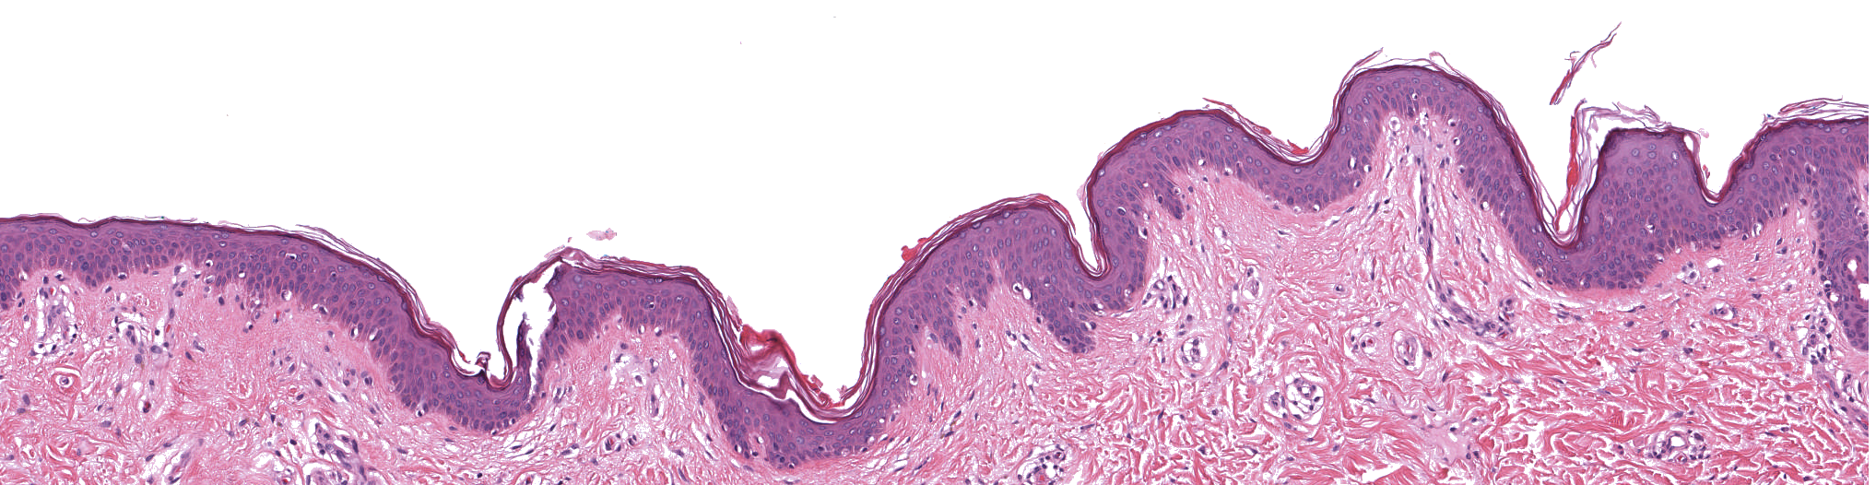
Segmentation of Prognostic Tissue Structures in Cutaneous Melanoma using Whole Slide Images
Adon Phillips*
EECS
Iris Teo
Pathology and Lab. Medicine
Jochen Lang
EECS

Slide 2
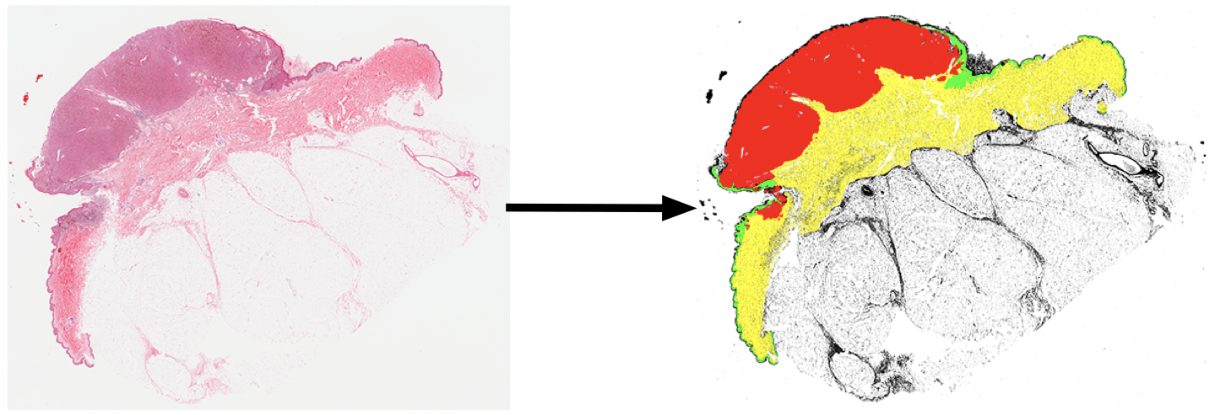
Motivation
Long term augmentation of clinical workflows
Previously unexplored
Research Questions
Overcome tissue variation and data proportion challenges?
Achieve sufficient accuracy to manually measure the Breslow thickness?

Slide 3
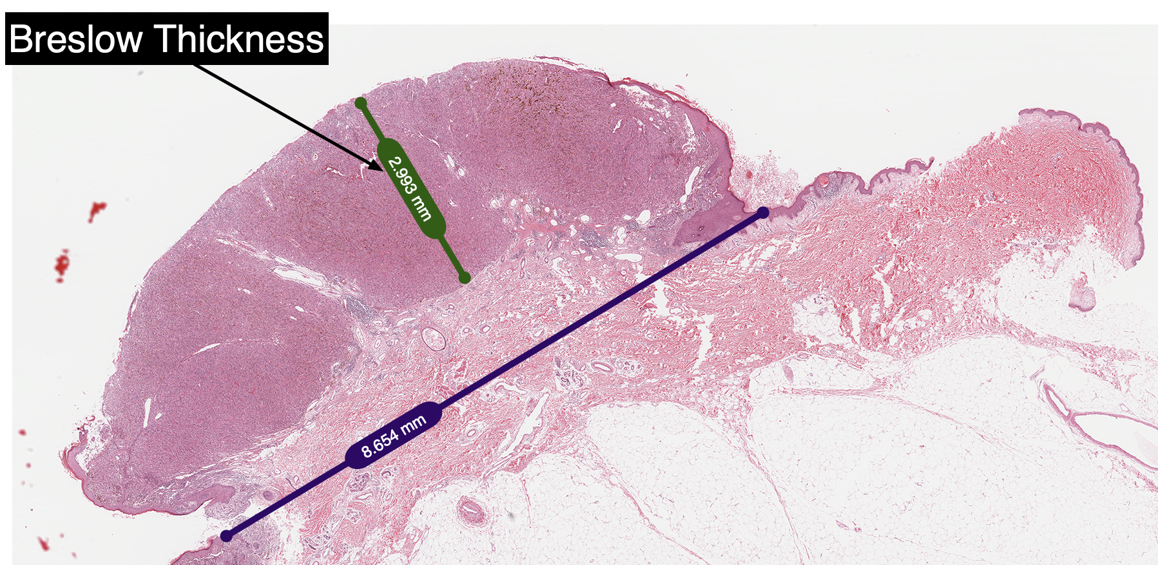
Breslow Thickness (aka depth)

Slide 4
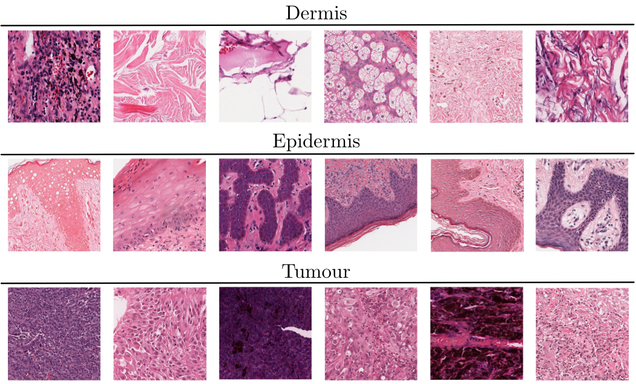
Challenge: Tissue variation
Morphology
Stain variation

Slide 5
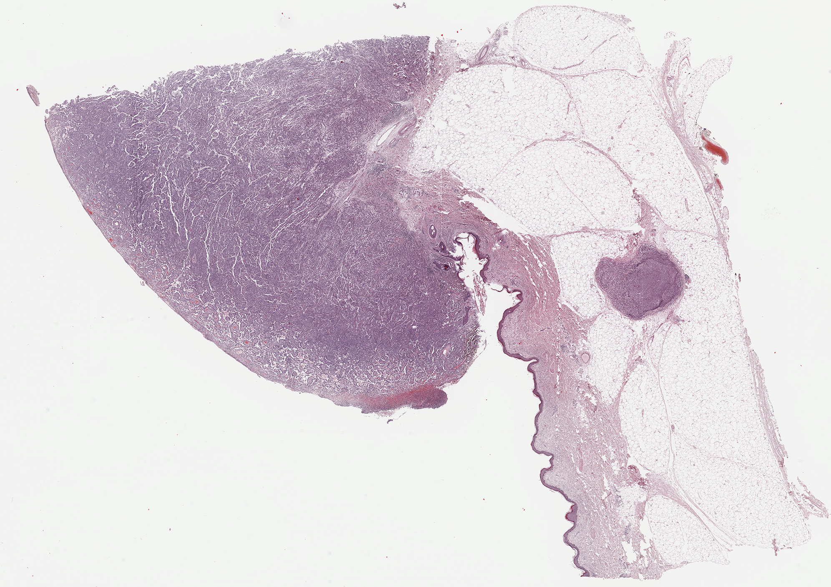
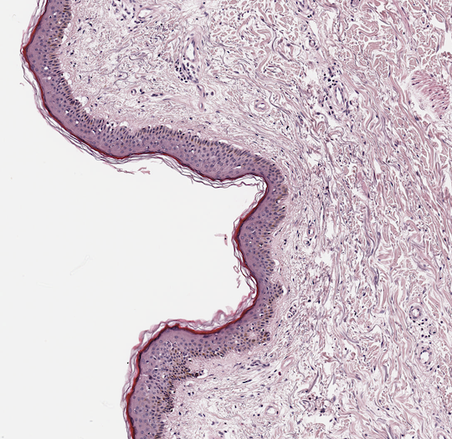
Challenge: Tissue proportions

Slide 6
Method Overview
Curate a dataset of annotated whole slide image pairs
Develop a neural network architecture specifically designed to address the challenges of our dataset and a pipeline to process WSIs
Train a model to detect and localize structures important for melanoma prognosis.
Manually measure Breslow thickness on model output to assess practical accuracy

Slide 7
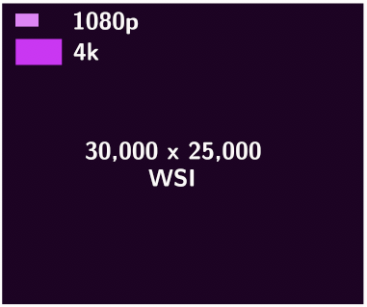
Dataset
Source data: The Cancer Genome Atlas (TCGA)
50 WSI from 49 patients selected from an overall pool of 1000 from HSCM
Dataset is divided into training, validation, and test sets at a ratio of 70:15:15 percent respectively
Due to the giga-pixel resolution of the WSIs, each slide is tiled to create image patches at 512x512 pixel resolution
Patches not containing tissue matter were discarded from the training set

Slide 8
Annotations
Three tissue classes: epidermis, dermis, tumour + background, NDI
Tissue classes annotated by practicing dermatopathologist
40x objective resolution
Selected Adobe Photoshop over all other options
Scripted ingestion and saving operations
Allowed semi-automated annotation workflows
Annotations could be applied at arbitrary apparent resolutions
Best performance on large images versus many other tools tested
50 cases annotated in ~35 hours

Slide 9
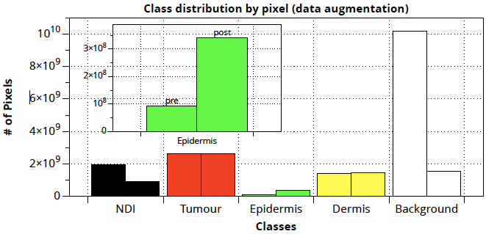
Data Augmentation
Large class imbalance: Epidermis pixels outnumbered by other classes
Tumour to Epidermis 28:1
Oversample Epidermis
Find patches containing mostly epidermis
Apply various transforms to each e.g. flip, rotate
Result is a new ratio of 7:1
Undersample NDI and Background

Slide 10
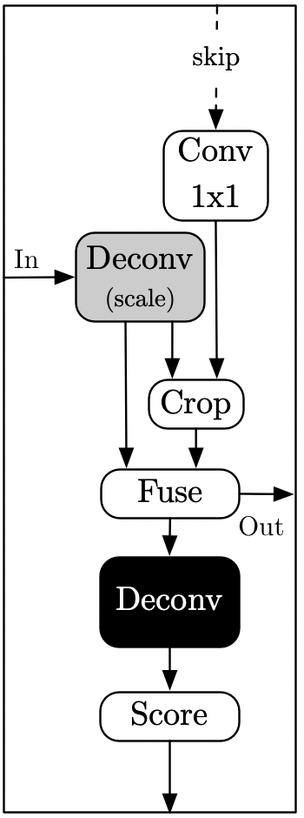
Network Design
Combined upscaling blocks
Upscaling Block
Fully Convolutional Network (FCN) inspired by the work of Long et al.¹
IDEA: Include information at multiple levels of granularity to improve learning under the following conditions:
High frequency granular features
Low contrast between boundary regions
SOLUTION: Compute deconvolutions (transposed convolutions) at multiple levels of granular detail
Generalize to a upsampling block
Combine coarse, medium, and fine blocks
Provide a weighting to scale the contribution of each block
¹Jonathan Long, Evan Shelhamer, Trevor Darrell: Fully convolutional networks for semantic segmentation. CVPR 2015: 3431-3440

Slide 11
Training
Train using stochastic gradient descent with cross entropy loss for a total of 40 epochs
Transfer learning
Network weights were initialized with publicly available values trained on the ImageNet and PascalVOC datasets for the base convolutional layers that our network shares with FCN-16

Slide 12
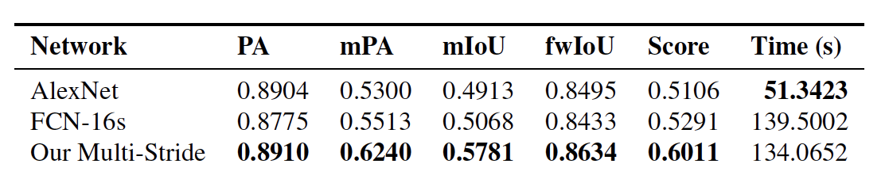
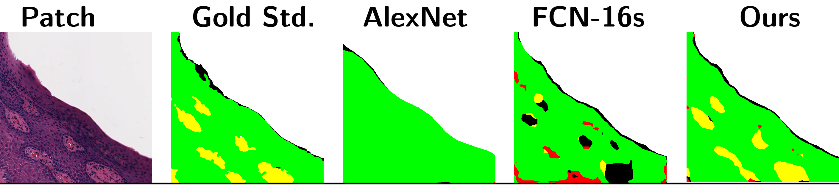
Network Comparison
To evaluate our network design we compared the results against the baseline FCN-16s and an FCN conversion of AlexNet²
Our network showed superior performance to the comparators based on our selected standard metrics
The performance improvement derives from the multi-stride upsampling information that is better able to capture a mix of both coarse and fine details
² Alex Krizhevsky, Ilya Sutskever, Geoffrey E. Hinton: ImageNet Classification with Deep Convolutional Neural Networks. NIPS 2012: 1106-1114

Slide 13
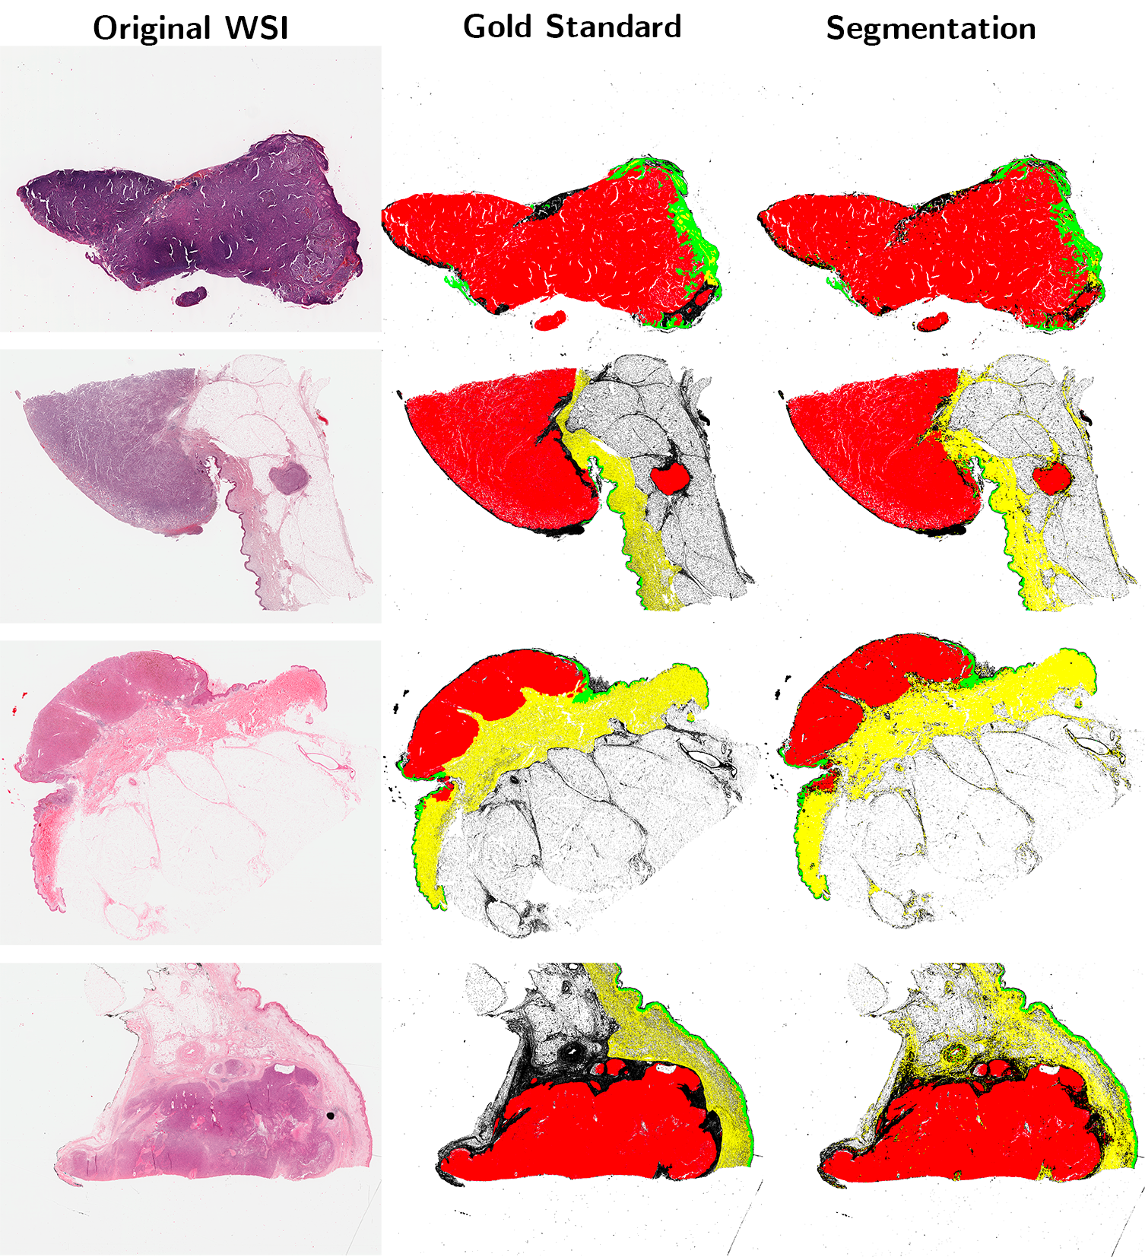
Qualitative Results:
Our results show a strong approximation of the gold standard annotations

Slide 14
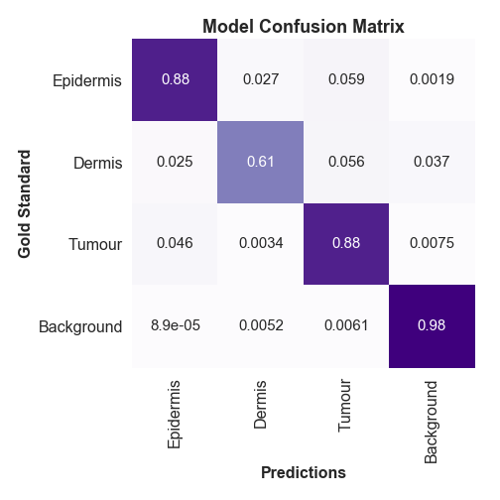
Quantitative Results
Strong differentiation between tissue types
Boundary regions prone to error
Tumour regions accurately detected and localized with most false positives being small localized clusters.
Very good performance on epidermis segmentation
Dermis superficial boundary differentiated but deep boundary is problematic

Slide 15
Breslow Thickness on Test cases
We asked a group of four pathologists to measure the Breslow thickness for the test cases as processed by our model
When compared with the ground-truth measurement there was 87.5% agreement between the independent measurements
Supports the conclusion that our output segmentation masks are sufficiently accurate to make the measurement.

Slide 16
Conclusions
We have demonstrated a method capable of detecting and localizing melanoma tumours and other tissue structures important for prognostic measurements
It is possible to overcome the discriminative challenges of the skin and tumour anatomy for segmentation.
It is possible to achieve the level of accuracy required to manually perform the Breslow thickness measurement. More work is required to improve the network’s performance on dermis segmentation.

Slide 17
Please find the associated paper at:
http://openaccess.thecvf.com

